Slide 1



Slide 2

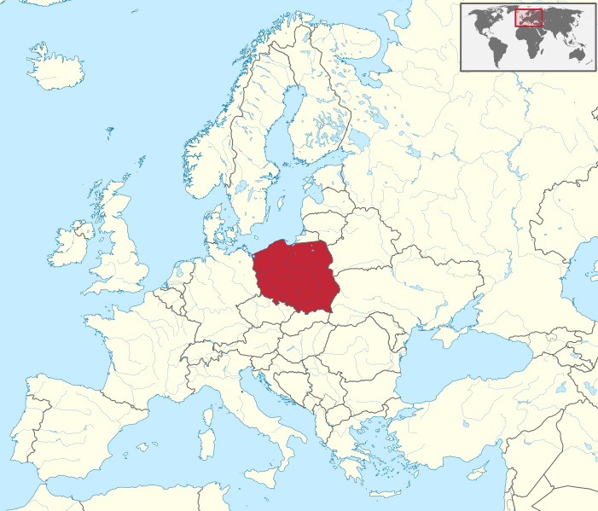
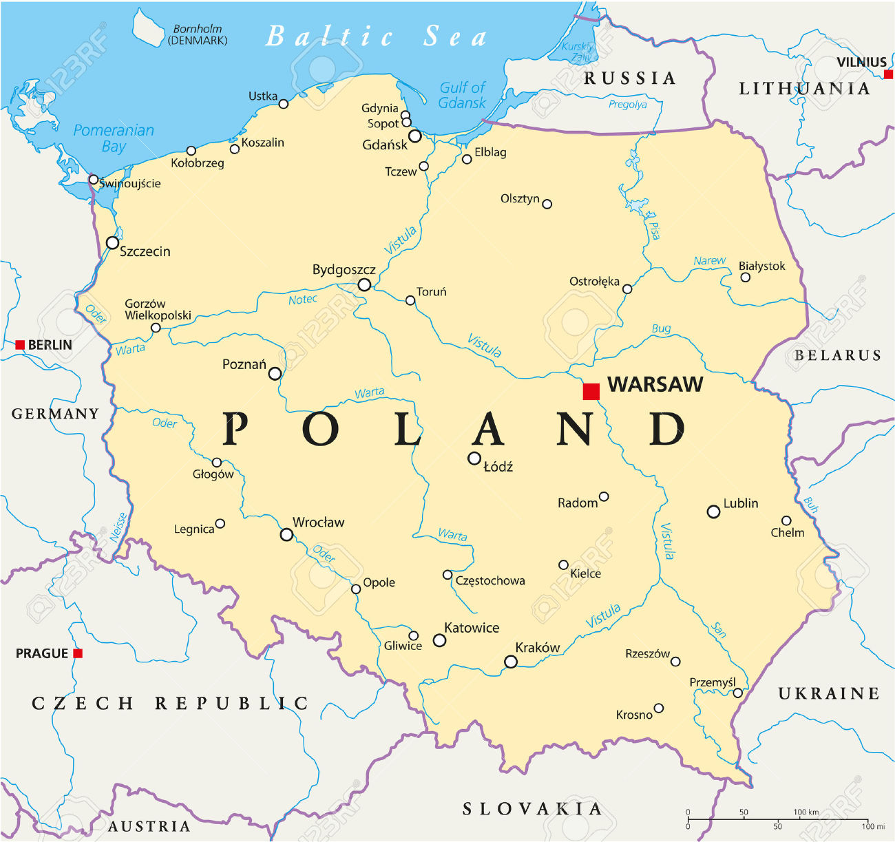
Location
Warsaw University of Technology (WUT) is one of the largest
universities of technology
in Central Europe.
WARSAW
Warsaw University of Technology
is located in the capital city.
Warsaw is the heart of Poland.

Slide 3

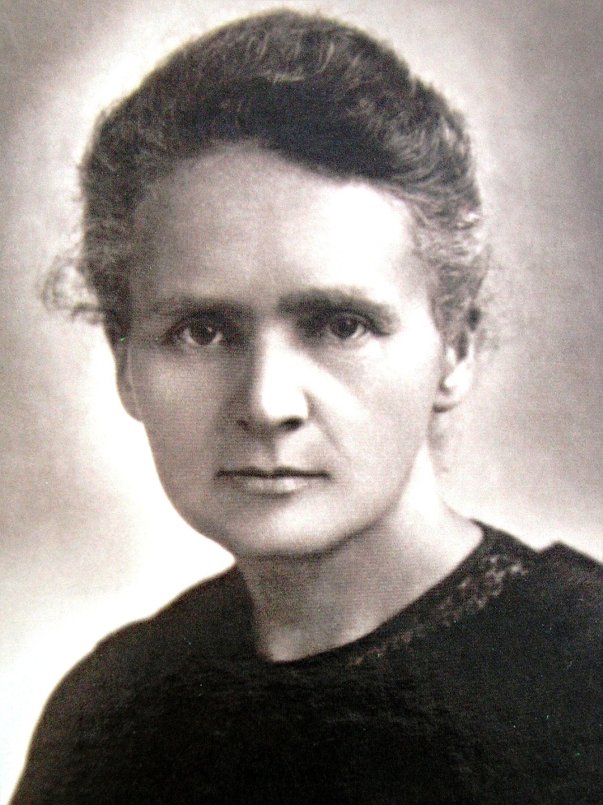
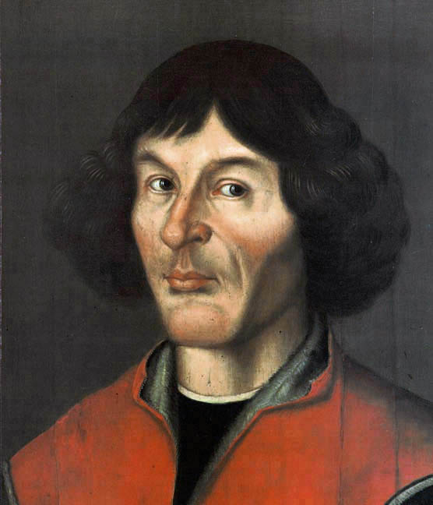


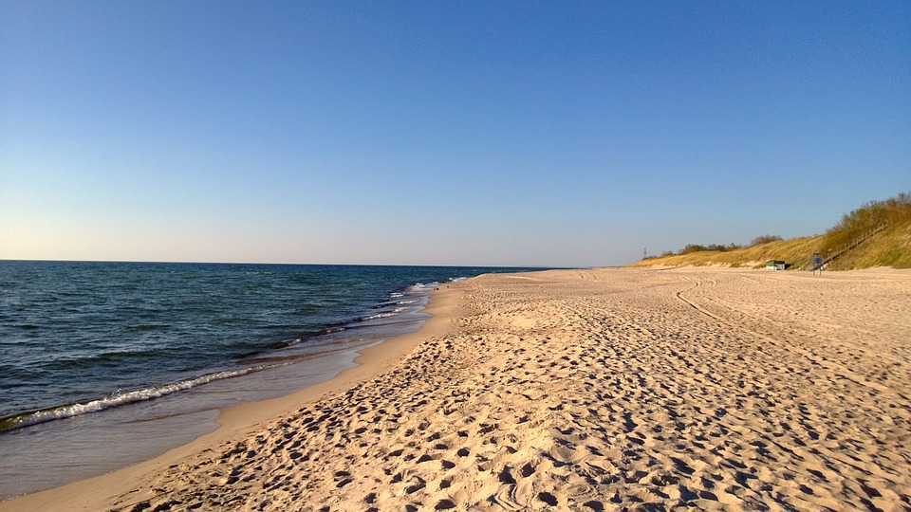
Visiting Poland
Poland is worth visiting. It offers beautiful landscapes – Tatra Mountains
and Baltic Sea are only the highlights.
Poland is the homeland of people who influenced science and technology, for example:
Nicolaus Copernicus – the astronomer and mathematician who formulated the model of the solar system.
Maria Skłodowska-Curie – the physicist and chemist, doctor honoris causa of Warsaw University
of Technology. She was the first woman in history to win the Nobel Prize. What is more,
she was awarded twice – in 1903 with her husband Pierre Curie for research on radioactivity
and in 1911 for her discovery of radium and polonium.

Slide 4

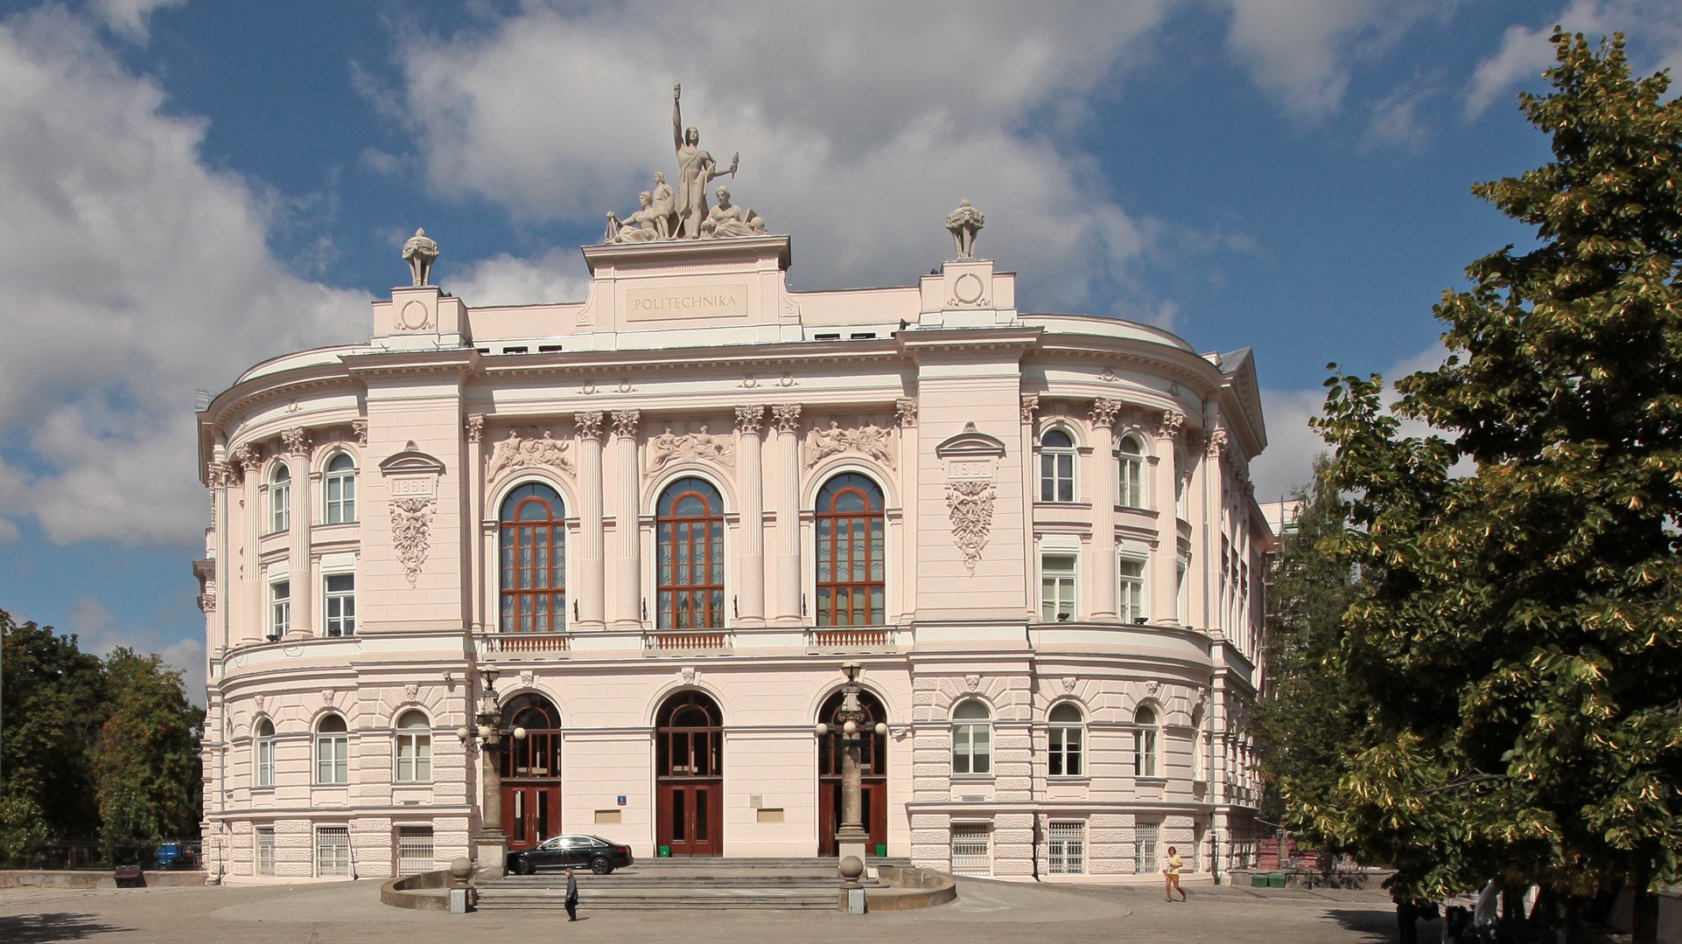
WARSAW UNIVERSITY OF TECHNOLOGY – THE HISTORY
1826 – Foundation of the Polytechnic Institute. Stanisław Staszic was the man who played the most
important part in creating process
1898 – Opening of Emperor Nicolas II University
of Technology in Warsaw
1915 – Polish became the language of instruction
at the Warsaw University of Technology
1944 – WUT was reactivated after The World War II
1951 – The Faculty of Communication was separated from the Faculty of Electrics. It was the beginning of the Faculty of Electronics and Information Technology

Slide 5
WARSAW UNIVERSITY OF TECHNOLOGY - STATISTICS
19 faculties and 1 college, where
Over 36 000 students
2500 academic teachers
19 faculties
32 fields of study
Cooperation with over 180 foreign universities

Slide 6
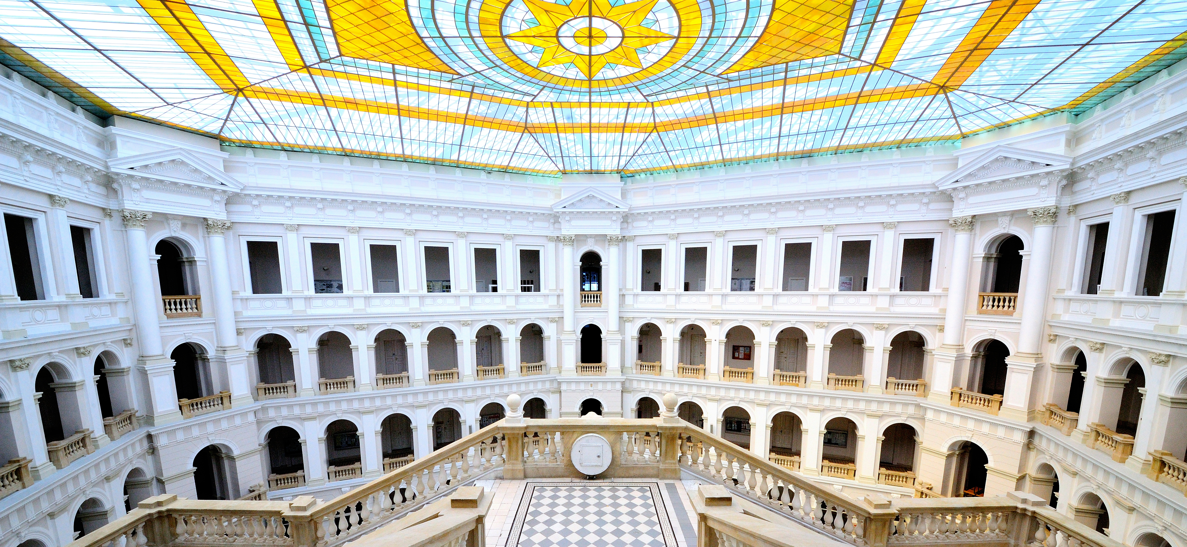
The Main Hall ot WUT is one of the most significant places in Warsaw

Slide 7
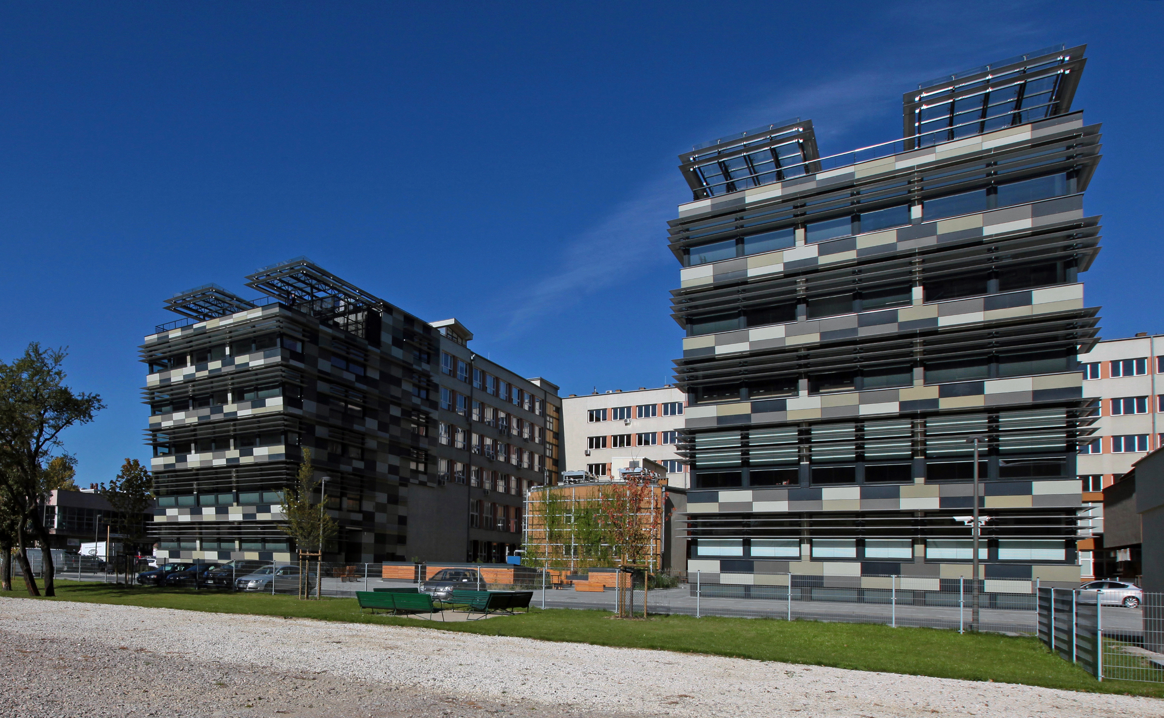

Slide 8
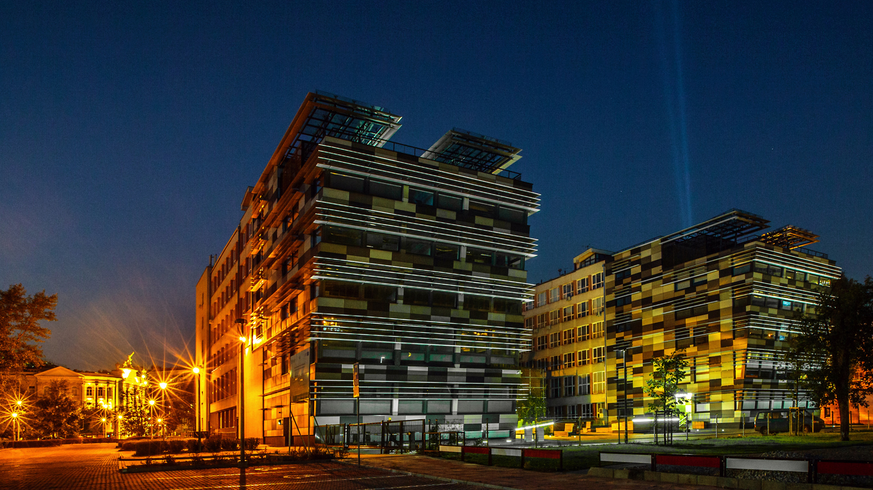
Faculty of Electronics and Information Technology in numbers:
19 faculties and 1 college, where
Over 3000 students and 200 PhD students
Over 300 academic teachers
6 institutes
400 courses
50 laboratories

Slide 9
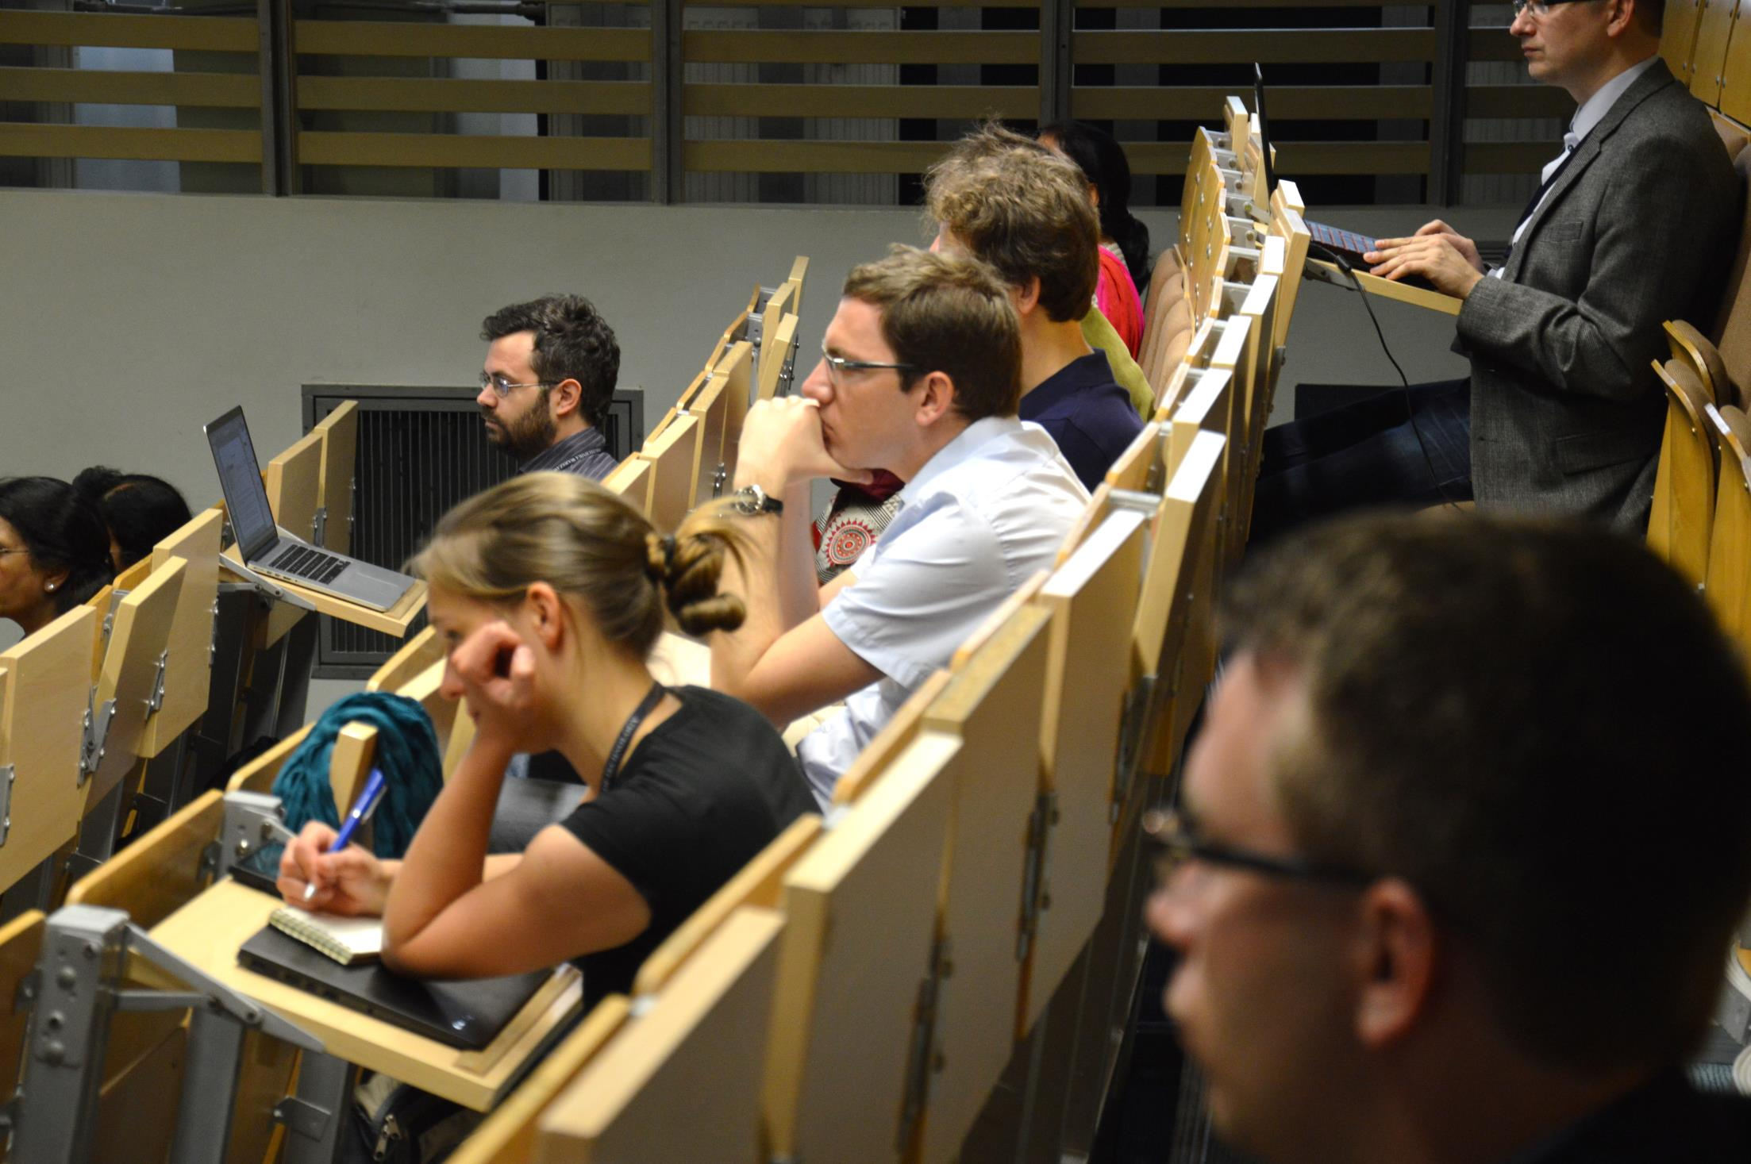
STUDIES IN ENGLISH
The Faculty of Electronics and Information Technology offers
full-time undergraduate and graduate studies in English
The area of study encompasses
Computer Science
Telecommunications
leading to:
B.Sc. Degree,
M.Sc. Degree

Slide 10
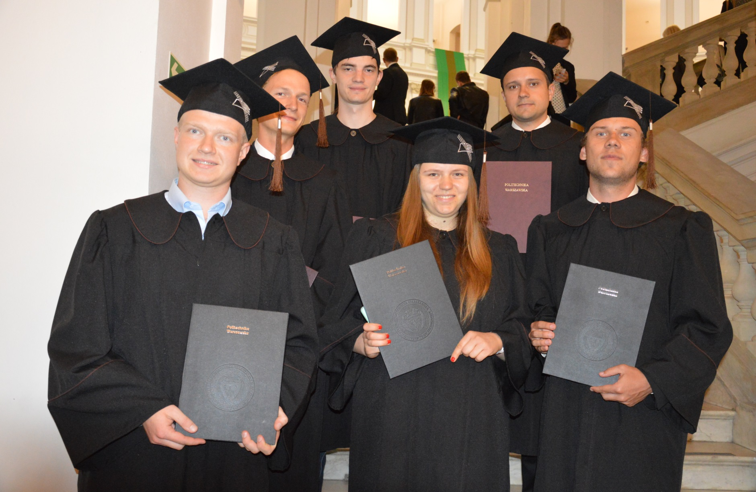
PH.D. STUDIES IN ENGLISH
The Faculty of Electronics and Information Technology offers full-time and part-time doctoral programmes leading to Ph.D. degree in the area of:
Automatic Control
Computer Science
Electronics
Telecommunications

Slide 11
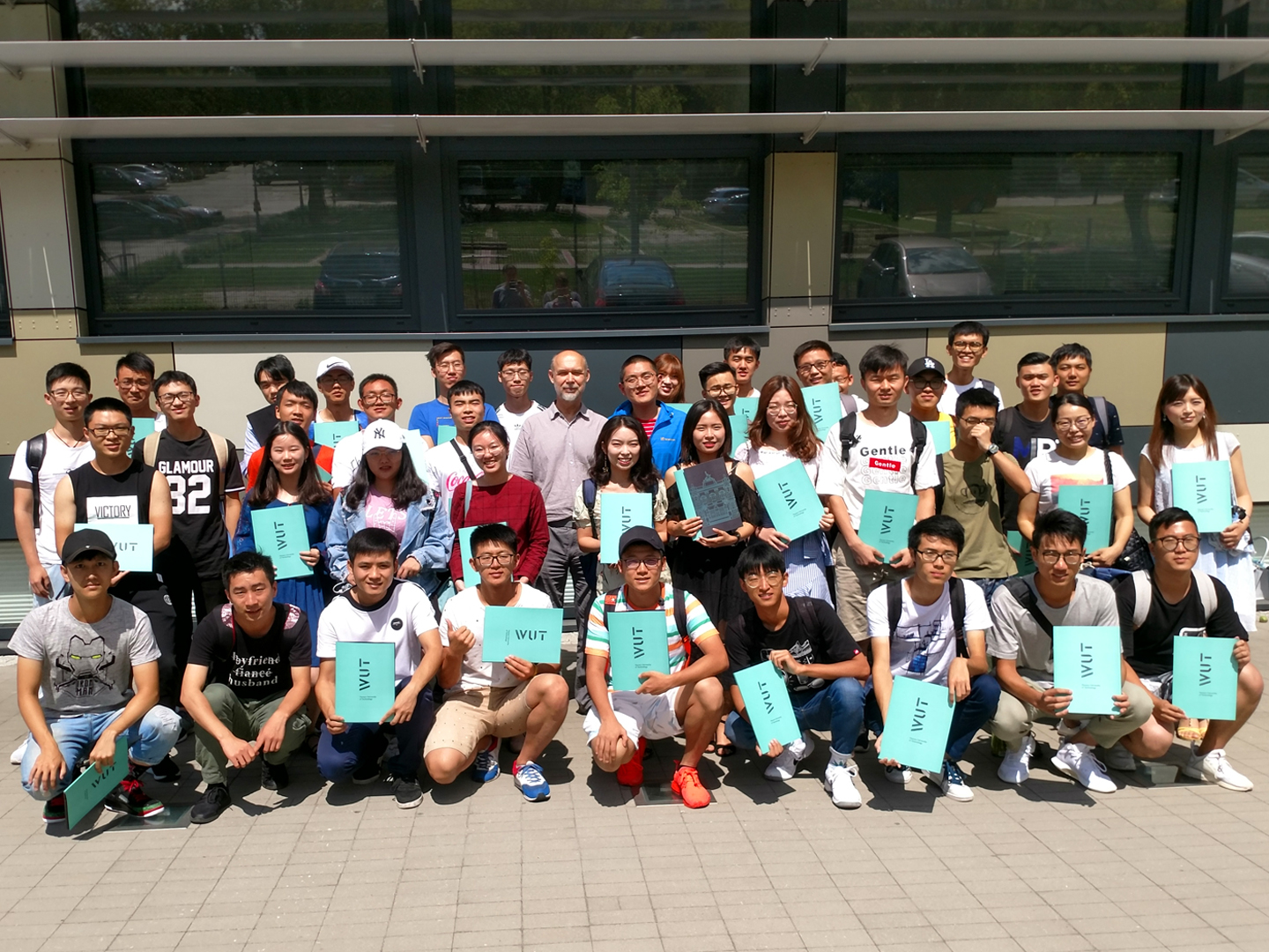
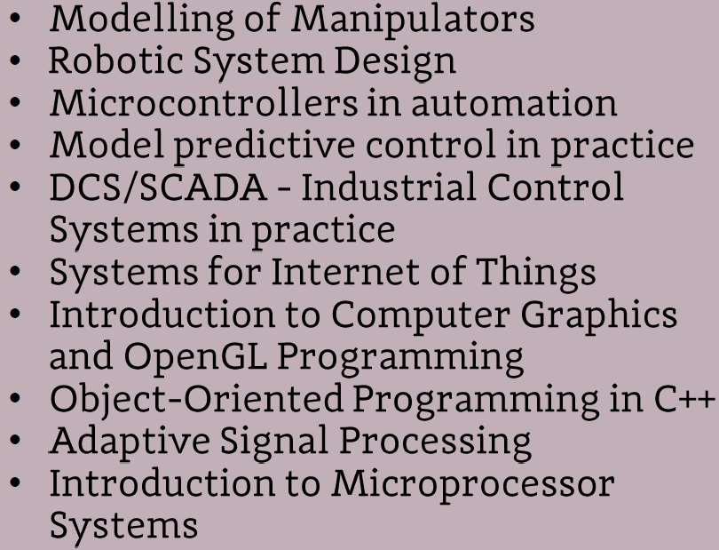
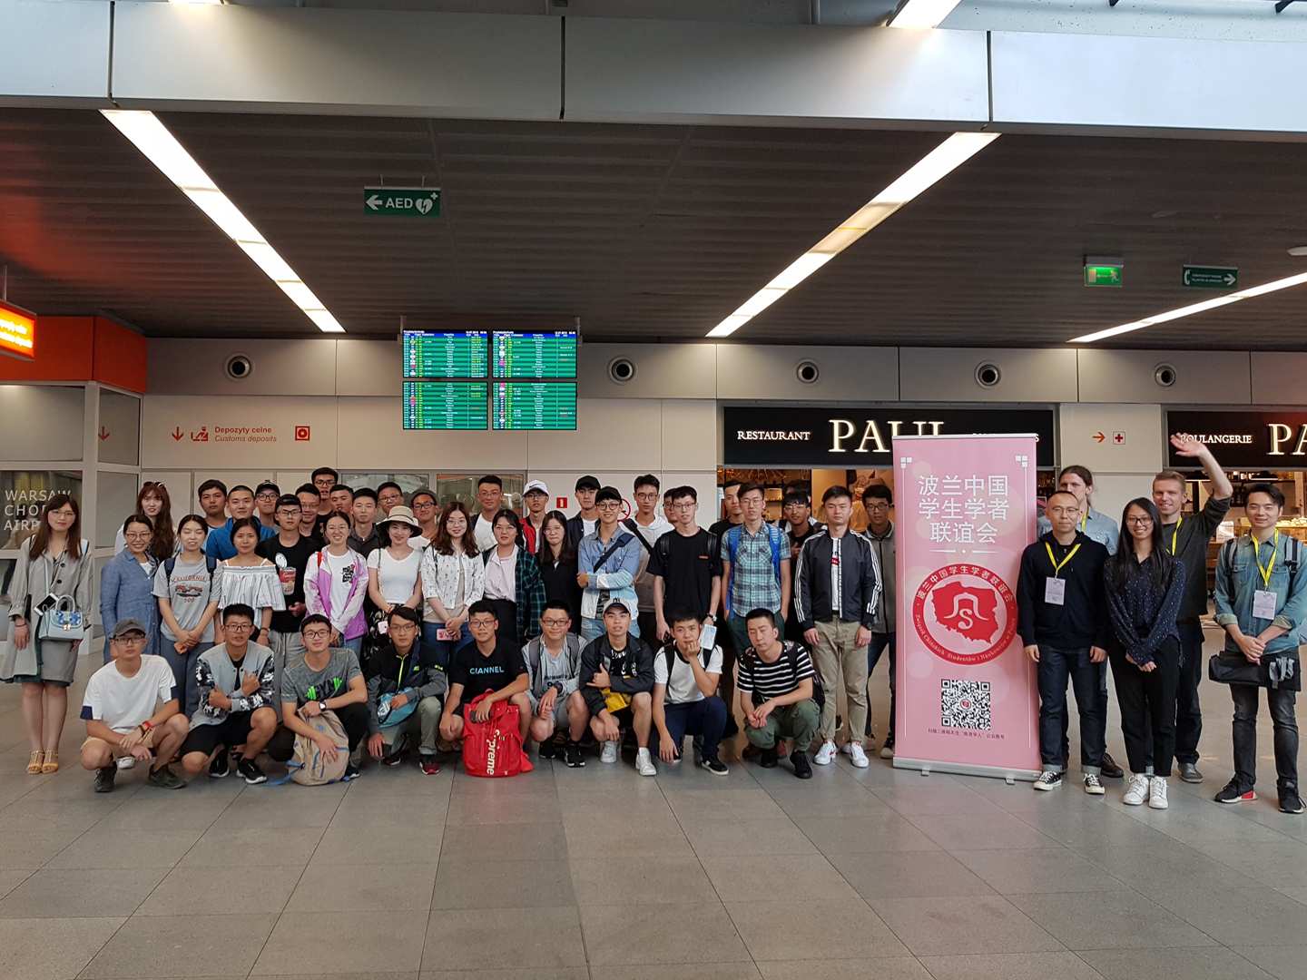
SUMMER SCHOOL OFFER
Topics:

Slide 12

E-LEARNING IN POLISH
We offer Distance Learning in Polish in cooperation with the
Center for Open Education – OKNO
The program of study leading
to the B.Sc. Degree (undergraduate),
a four-year program
major: Electronics and Telecommunications
The program of study leading
to the M.Sc. Degree (graduate),
is a two-year program
major: Computer Science

Slide 13
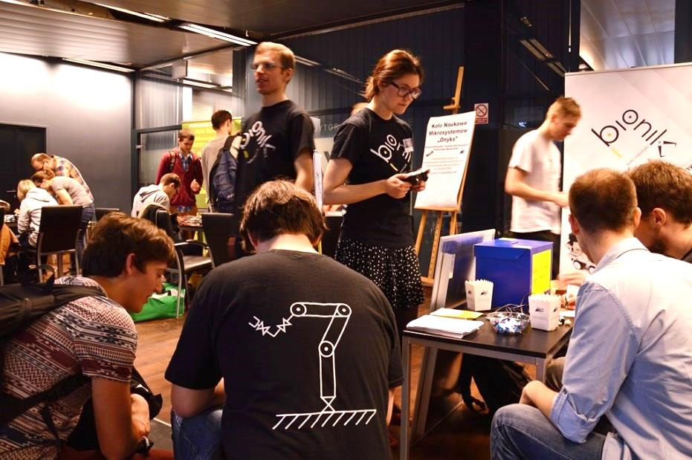
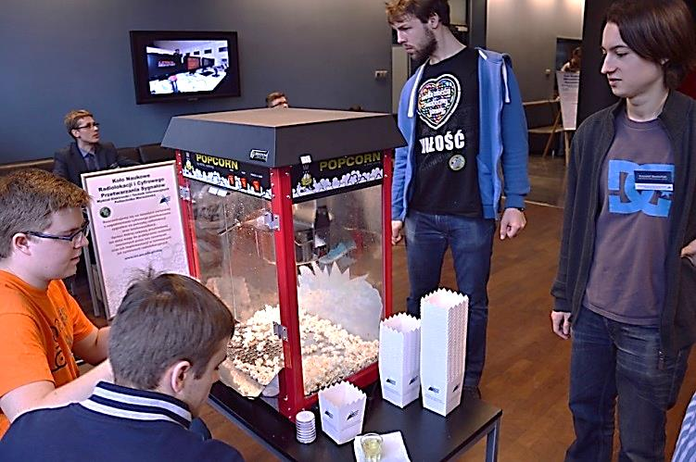
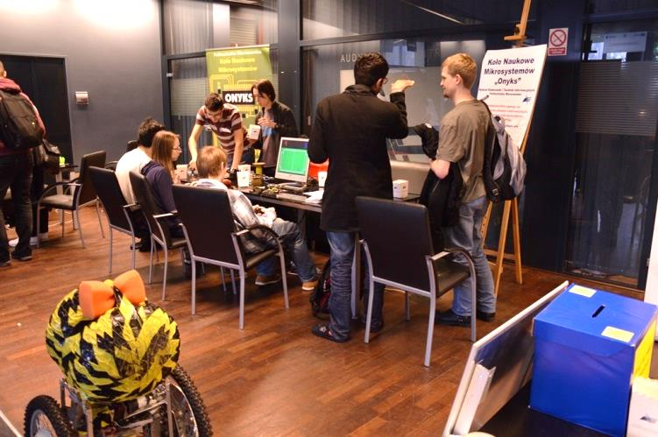
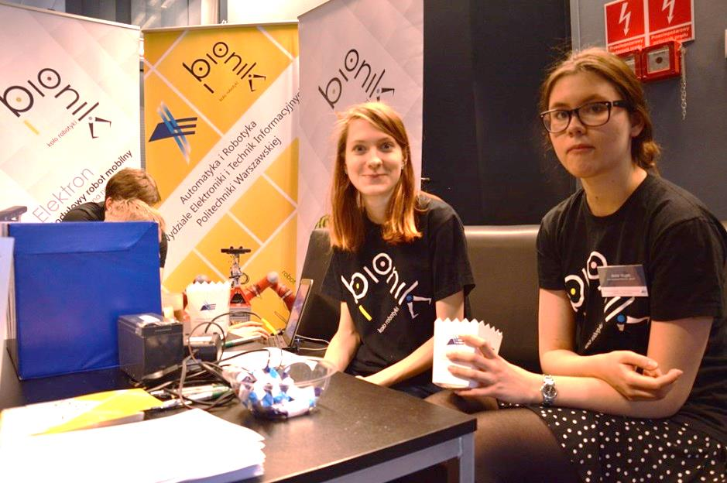
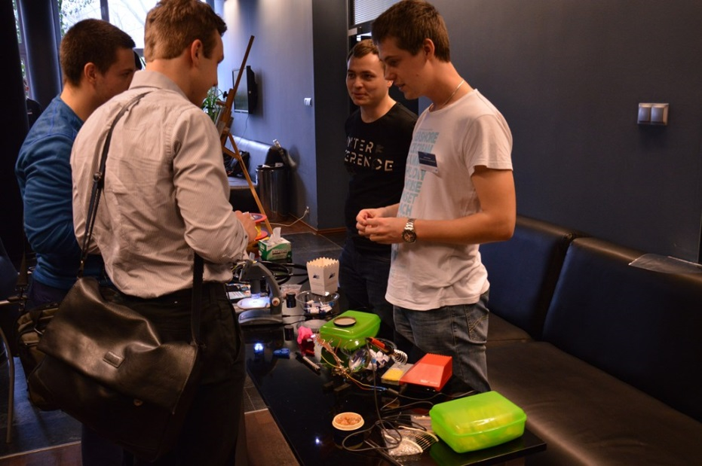
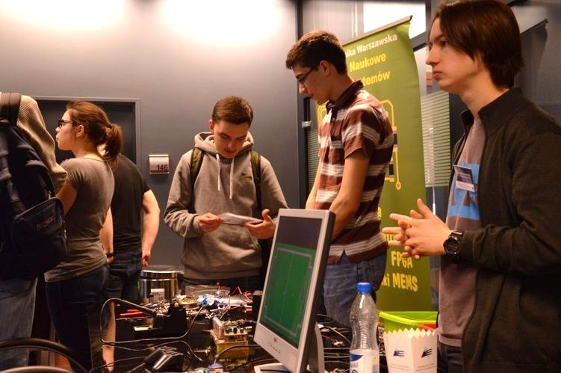
STUDENTS RESEARCH CLUBS
Students carry on research under the supervision of Faculty staff and develop their scientific interest and practical skills. There are about 20 students research clubs.

Slide 14

INTERNATIONAL EXCHANGE
from academic year 2013/2014 to 2017/2018
268 of our students abroad
546 foreign students at our Faculty
13 cooperation agreements - Kyungpook National University (Korea); University of Ulsan (Korea); University of Luxembourg; University of Newcastle (Australia); University of Western Australia; University of Nottingham (UK); Bauman Technical University (Russia); Vilnius College of Higher Education (Lithuania); Polytech Nantes (France); Technische Universitaet Berlin (Germany); Universidade Nova de Lisboa (Portugal); Technische Universiteit Eindhoven (Netherlands), Toyama University (Japan)
17 courses within the ATHENS Programme (450 incomming students)
18 invited foreign professors lecturing at our Faculty

Slide 15
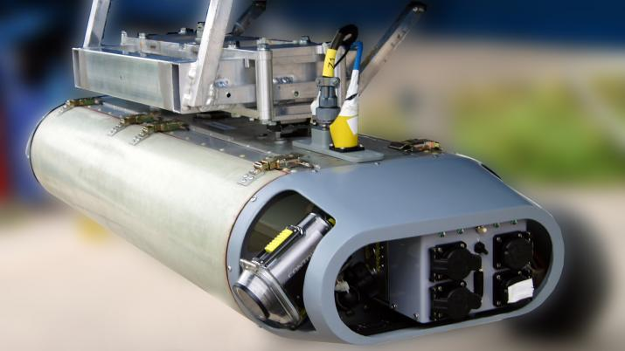
RESEARCH HIGHLIGHTS

Slide 16
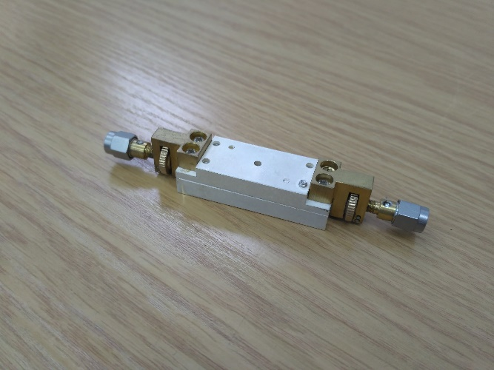
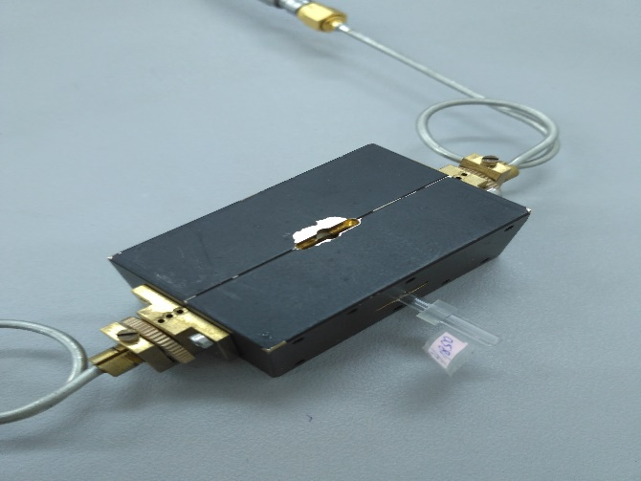
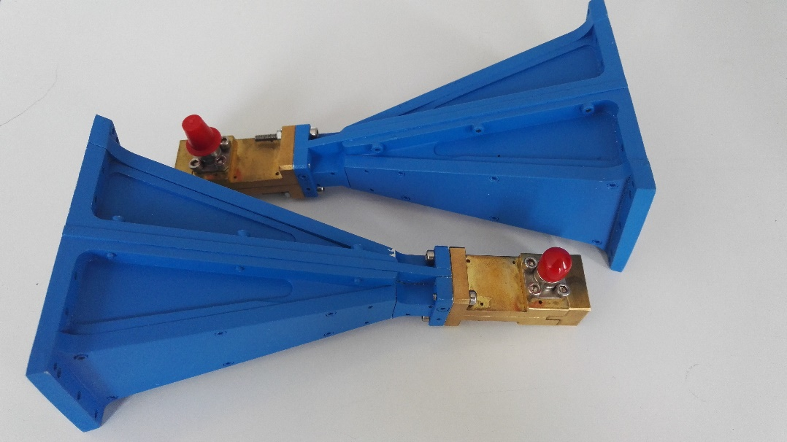
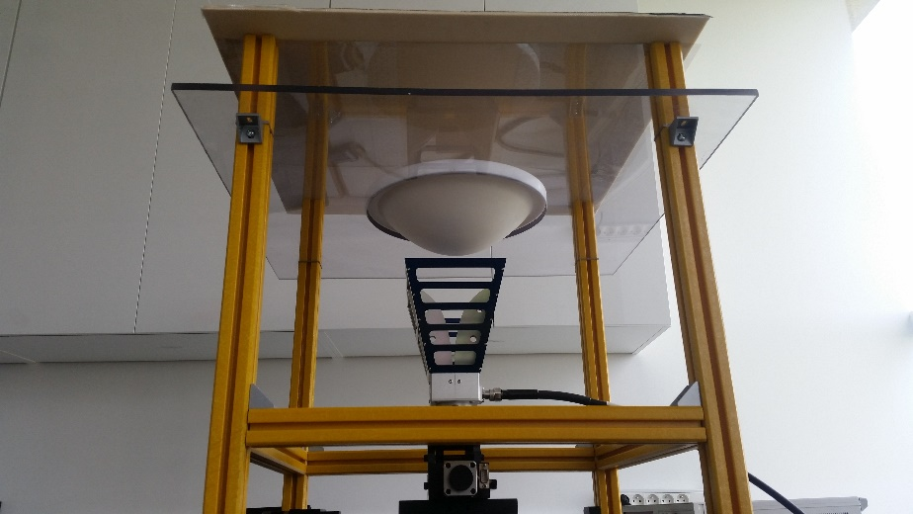
Microwave/mm-wave techniques
Microwave
and milimeter wave resonators
for materials characterization
Resonant measurements of ferromagnetic materials
Measurements
of broadband flexible absorbers
Development and characterization
of milimeter wave antennas

Slide 17
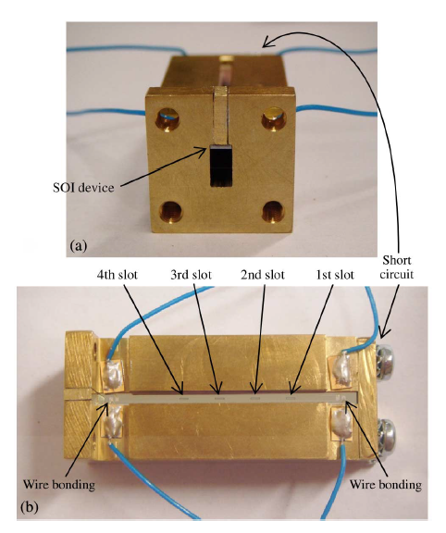
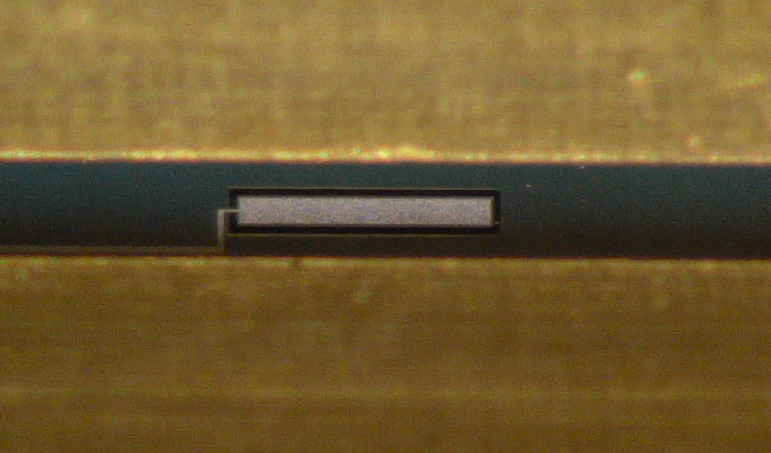
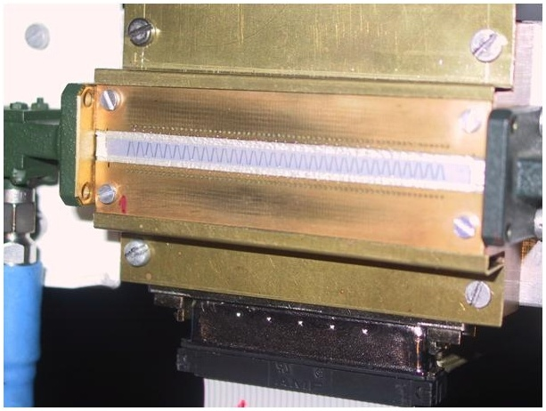
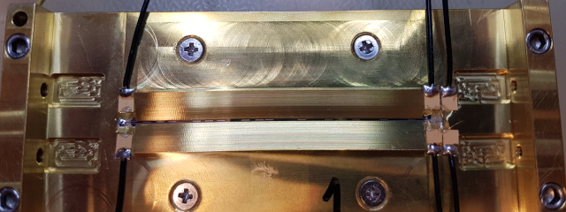
Smart Antennas
Smart antenna based
on spatial multiplexing of local elements (35 GHz)
Reconfigurable beamforming antenna (28 GHz)
Antenna system with reconfigurable aperture(22 GHz)

Slide 18
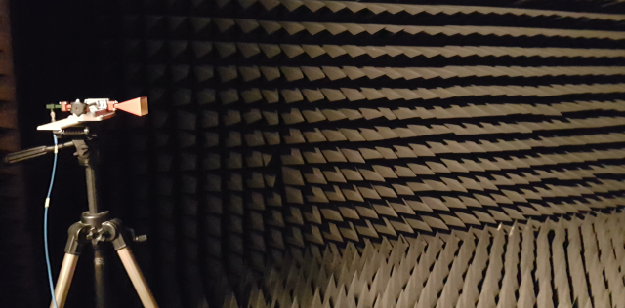
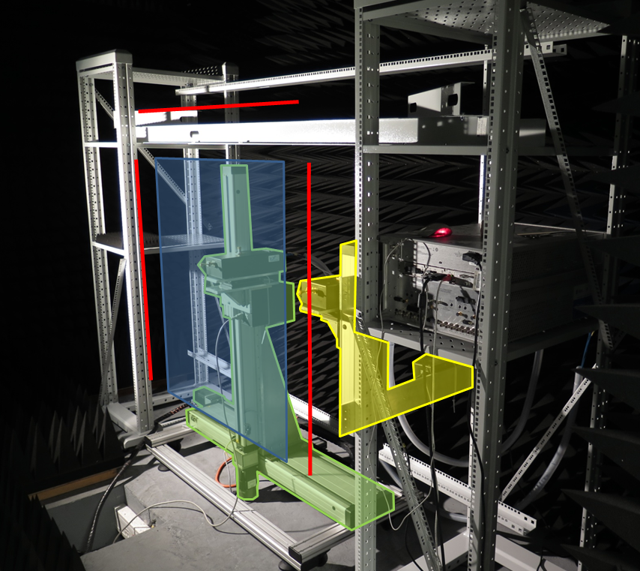
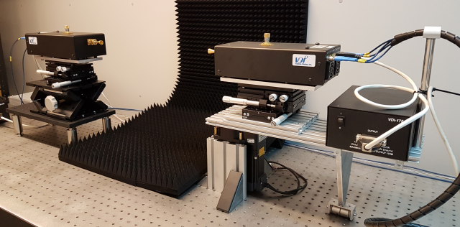
From 2 GHz to 500 GHz Measurements
Antenna measurements in spatial, frequency and time domains
Anechoich chamber
MIMO scanner
sub-THz station

Slide 19
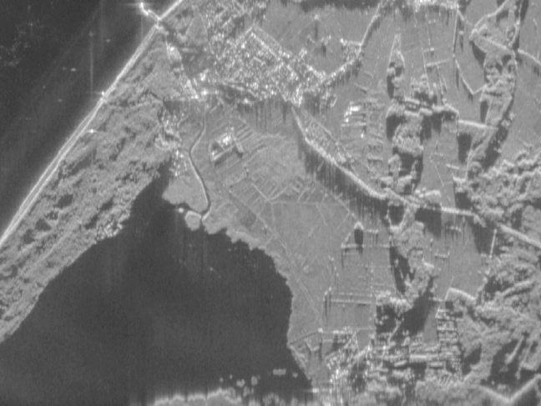

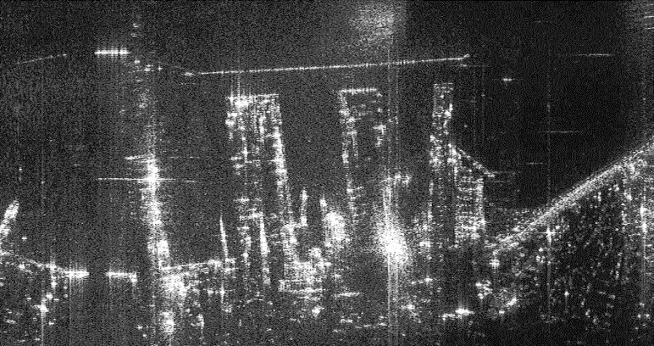
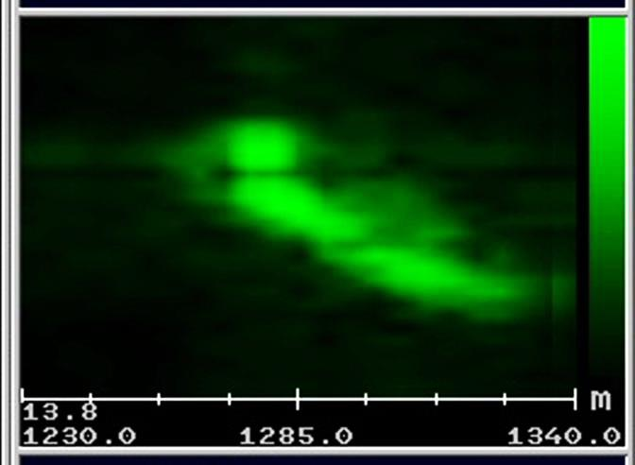
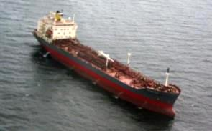
Radar Techniques
SAR images
Bryza patrol aircraft, X-band radar (in cooperation with Polish industry)
Radar operation modes:
patrol
SAR (Synthetic Aperture Radar) – terrain imaging
ISAR (Inverse SAR) – target imaging
ISAR image

Slide 20
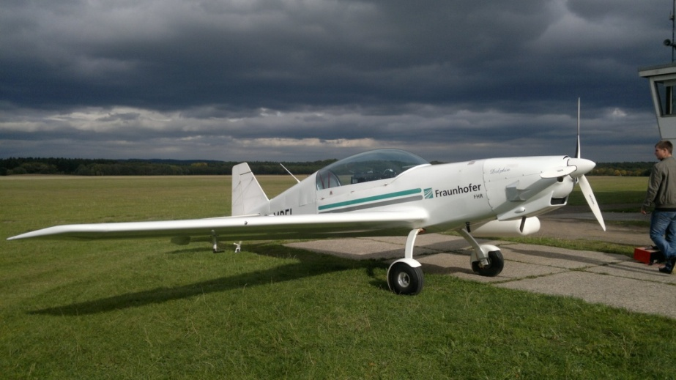
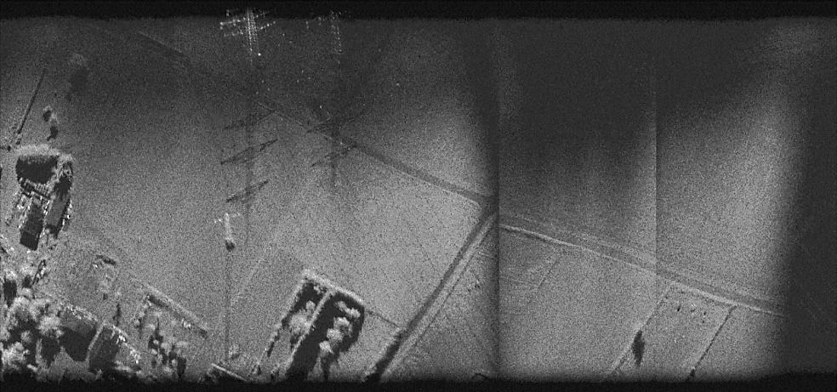
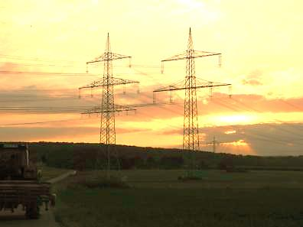
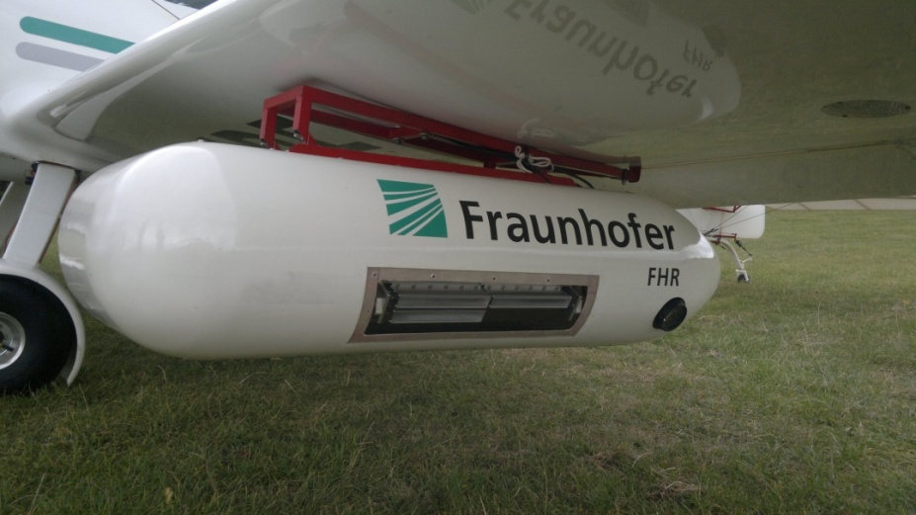
Radar Techniques
SARAPE project, European Defence Agency
SAR images, 15x15cm resolution
94GHz SAR radar

Slide 21
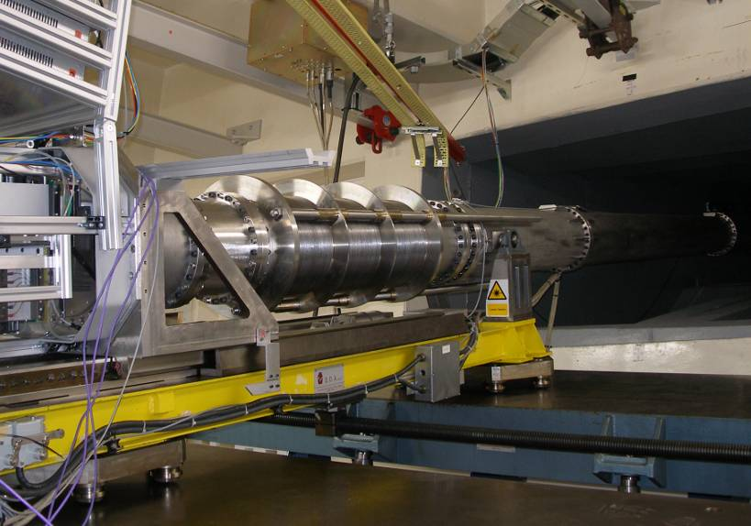
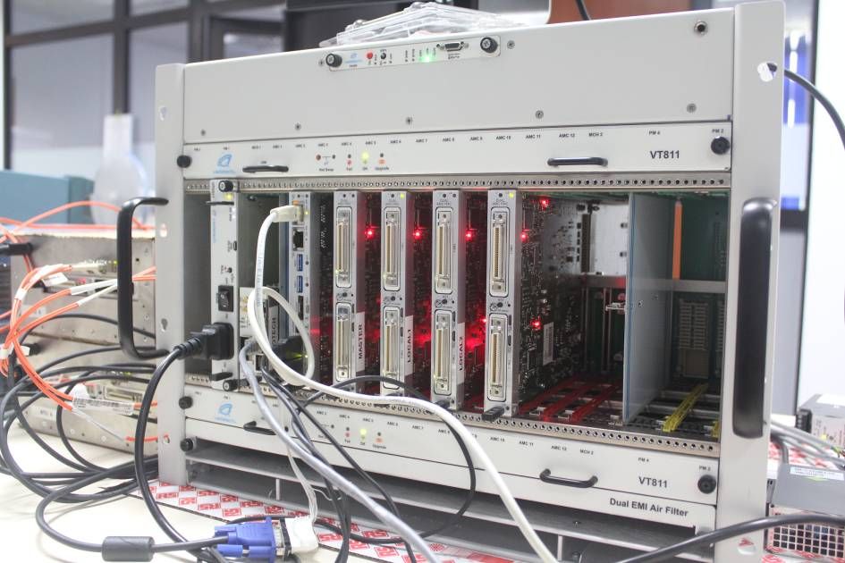
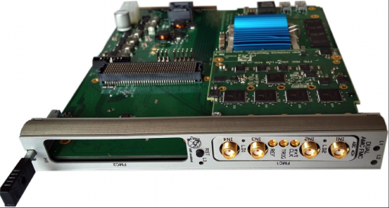
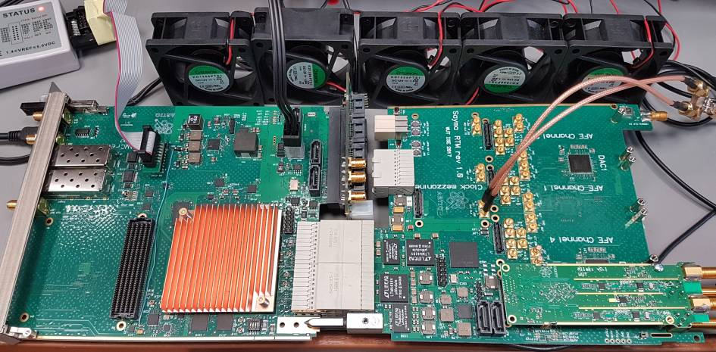
ELHEP – Electronics for High Energy Physics Lab.
Soft X-ray T-GEM detector at JET tokamak (Culham/Oxford, GB) with fast histogramming based on FPGAs
uTCA based high voltage diagnostic system for tokamaks
uTCA cubit controller for quantum computing
White Rabbit development

Slide 22
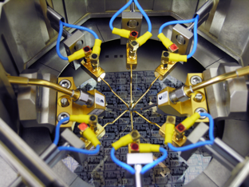
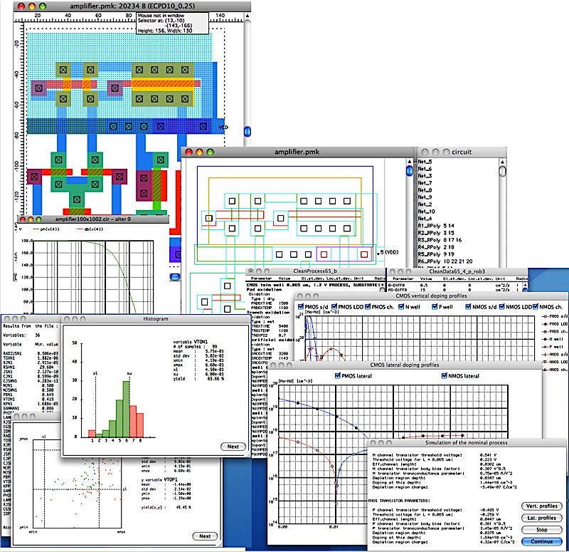
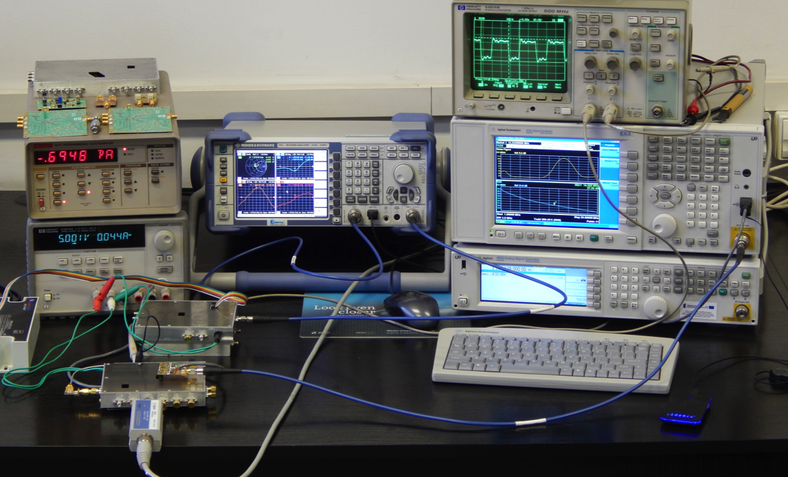
Microelectronic Integrated Systems
(1) IC design and testing labs
Design on Linux and MacOS platform
EDA tools development
for research and education
Highly accurate measurements for advanced testing and on-wafer characterization

Slide 23
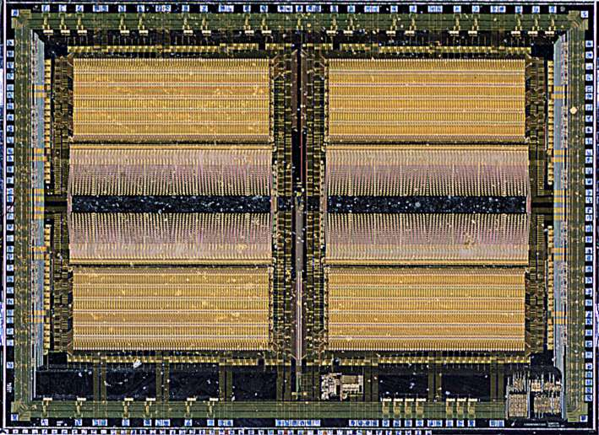
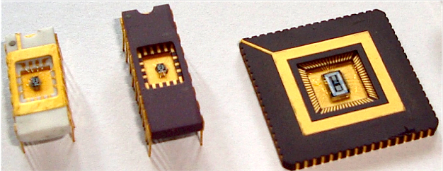
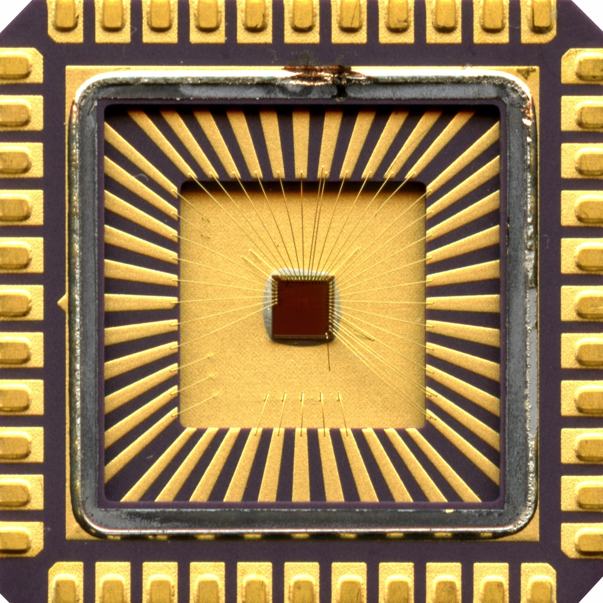


Microelectronic Integrated Systems (2)
Application Specific Integrated Circuits (ASICs)
PAC – for real time data processing, LHC, CERN
Design and development of ASICs for applications in medicine, telecommunication, scientific research, military techniques etc.
Chaotic – for secure
telecommunication
applications
A family of 32 bit microprocessors
of custom architectures dedicated to our SoCs

Slide 24




Design and silicon prototype of the first in the world low frequency low noise amplifier in 28 nm FDSOI technology
Microelectronic Integrated Systems (3)
Low noise amplifier for acquisition of bio-signals
Circuit layout
Ideally linear voltage transfer curve due to internal feedback applied to the transistor back gate (FDSOI specific solution)
Compensation of input gate leakage due to innovative “quasi-Darlington” input stage
RMS noise: 3.1 μV (1 Hz – 10 kHz)
European project “THINGS2DO”
(ENIAC GA 621221)
Prototype chip

Slide 25




Microelectronic Integrated Systems (4)
ASICs for applications in medicine
Analcomp – fuzzy logic based controller for heart pacemakers
BioSoC & HeC
System on Chip for miniaturized Telehealth/Telemedicine wearables

Slide 26






Microelectronic Integrated Systems (5)
ASICs for applications in outer space reserch and navigation
Rosetta mission
ASICs controlling operation of the comet penetrator and data transmission
GNSS & NaviSoC
Single-chip solutions for precise satellite positioning
GPS L1/L5 + Galileo E1/E5
double-system,
multi-frequency,
multi-purpose receivers

Slide 27









Microelectronic Integrated Systems (6)
VESTIC – a new ICs design/manufacturing paradigm
  Full layout regularity
  3D device and interconnect structures
  Possible process simplification and minimization
  of number of masks
  New twin gates junction less Vertical Slit FET
  Integration of all kinds of devices
D
G1
G2
TCAD simulations
S
CADENCE and IMiOCAD design tools
GOX or
p-n junction
Test modules
(e.g. Ring oscillator) – cooperation with Institute of Electron Technology

Slide 28



Photovoltaics
characterization of new materials for PV cells
data analysis and energy rate predictions
design and development of photovoltaic systems

Slide 29



Application specific photonics integrated cuircuits (aspics)
EEDH - Eastern Europe Design Hub (the only ASPICs-oriented R&D centre in EE)
Design and characterization of ASPICs for telecommunication, medical and military applications

Slide 30



Subwavelength photonic structures
Innovative structures including coatings based on metamaterials serving variety of photonic applications, including:
  Novel detection systems,
  Active spectral and angular filtering,
  Increasing solar cells efficiency.
Advantageous:
Low power consumption
CMOS compatibility
Nanoscale dimensions
Tailorable spectral range of operation

Slide 31




Fiber optic photonics
Short-wavelength fiber lasers (incl. up-conversion lasers)
NIR fiber lasers and amplifiers (incl. turn-key systems)

Slide 32


Polish Research Infrastructure for Experimentations on Future Internet Technologies
PLLAB 2020 is a distributed research infrastructure
connecting 6 labs in Poland via dedicated optical 10Gbps.
Integrated with European Fed4FIRE research infrastructure
Remote access to experiments via portal:
http://www.pllab.pl

Slide 33


Complex network analysis
structural resilience analysis for Polish autonomous systems (AS) network
churn prediction for telco customers based on their social graph analysis

Slide 34



Energy-efficient network control
save energy by wise routing
save energy by wise processor control
test in a dedicated testbed (@Econet FP7 project)

Slide 35


Telecommunication Systems
A world’s record for short range
optical data communication systems!
107 Gb/s transmission over 100 m and 54 Gb/s over 1 km of Multi Mode Fiber was achieved by our scientific team in 2016.

Slide 36

Optical system measuring selected body parameters
for the purpose of physiotherapy and biomedicine
FEATURES:
Non-ivasive and non-contact method of evaluation of selected body parameters;
Spatial position (x,y,z coordinates) of selected points are the result of measurement;
No scanning: all points are measured simultaneously, lag free;
System enables measurement of of the habitual posture – without any equipment stabilizing the musculoskeletal system of the examined, i.e.no forced position;
System enabling the evaluation of dynamic changes of the posture caused by different factors;
Differences between selected body positions or applied physical effort can be analyzed
System is portable

Slide 37




Robot Programming and Pattern Recognition Group
SwarmItFIX – Self- Reconfigurable Intelligent Swarm Fixtures composed
of robots
RobREx - Autonomy in rescue and exploration robots
Methodology of design and implementation of multi-sensory robotic systems for service purposes - Sonata 3
RAPP - Robotic Applications for Delivering Smart User Empowering Applications – cloud robotics

Slide 38






Care support for elderly and disabled people
by radar sensor technology (RadCare)
Impulse-radar sensors – promising means for reliable monitoring
of elderly and disabled persons
in their home environment
Long-term recording of data represenstative of day-and-night movements of a monitored person
Detection of dangerous events, such
as person’s falls,
and delivering
the results of data processing to the healthcare personnel
Extraction of information characterising the evolution
of the health status
of the monitored person

Slide 39



Algorithms for advanced process control
Nonlinear control algorithms for very fast processes, e.g. magnetic levitation and fast servomotor
Multicriterial assessment of control quality in large-scale industrial applications

Slide 40



High quality realistic stereoscopic visualization
and simulated holography
Perception based algorithms for analyzing
and controlling disparity in high-quality realistic stereoscopic visualization
(partially in cooperation with Max-Planck Institute and MIT)

Slide 41
THANK YOU FOR YOUR ATTENTION!
c.zielinski@ia.pw.edu.pl

